Slide 1
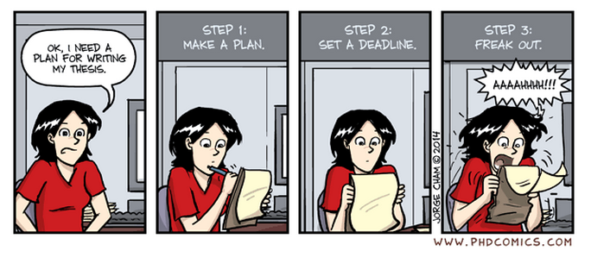

Birmingham International Academy
Thesis Writing for
Scientists and Engineers
Session 5: Conclusions & Abstract
Tutor’s name: Jane Sjoberg j.e.sjoberg@bham.ac.uk
Please sit near other people

Slide 2

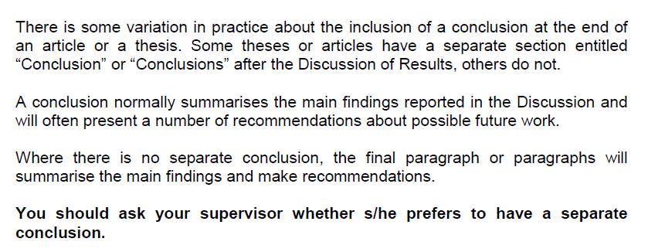

Slide 3
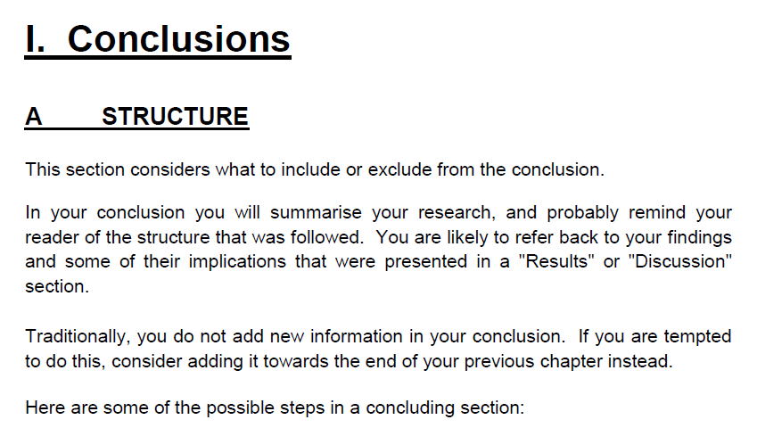
Summarise: don’t just repeat for the sake of it – highlight your key point(s) for a strong ‘take-home message’

Slide 4
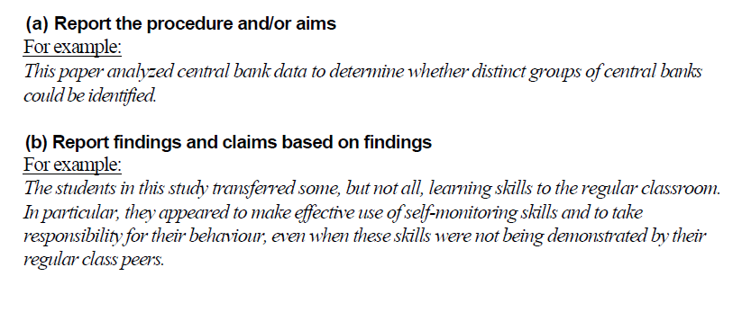

Slide 5
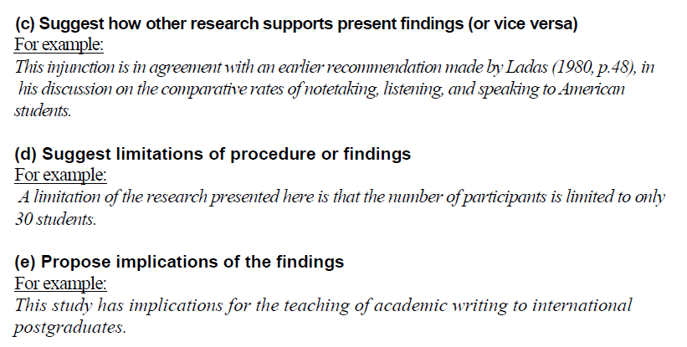

Slide 6
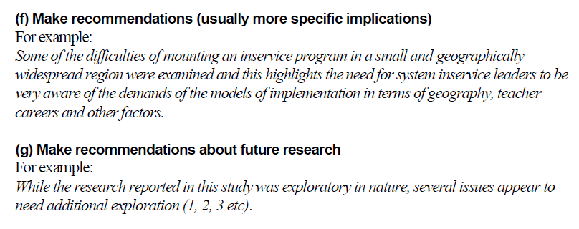
Even if brief, try to be as specific as you can: e.g. say how further research will be beneficial

Slide 7
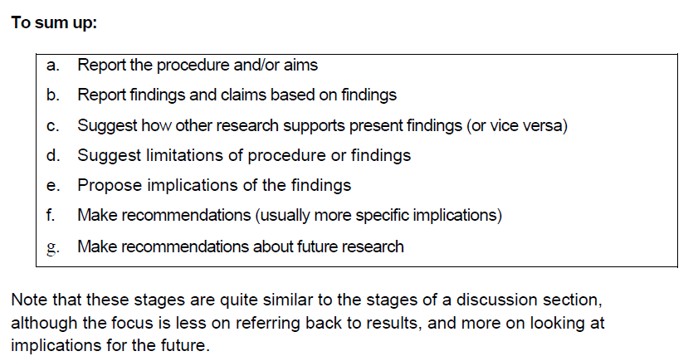
Useful language structures for conclusions
http://www.phrasebank.manchester.ac.uk/writing-conclusions/

Slide 8
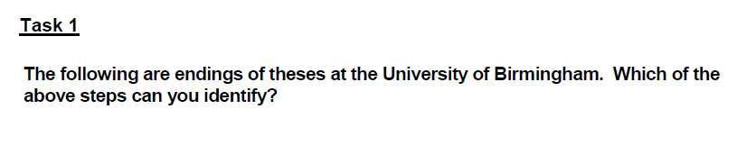


Slide 9
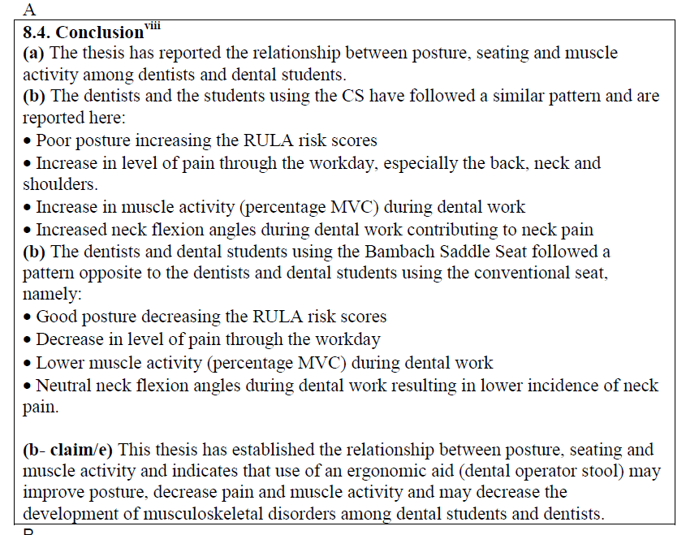


Slide 10
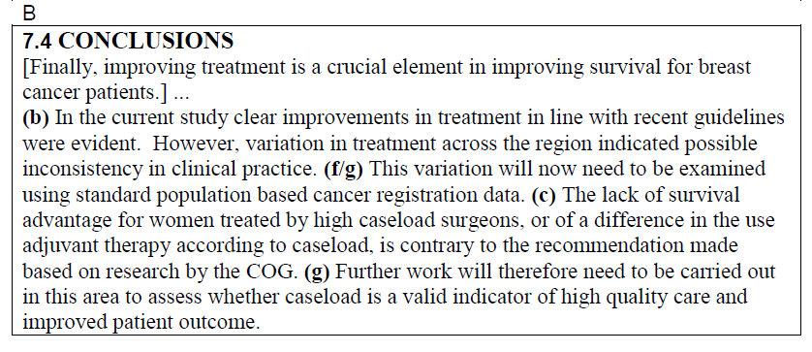


Slide 11
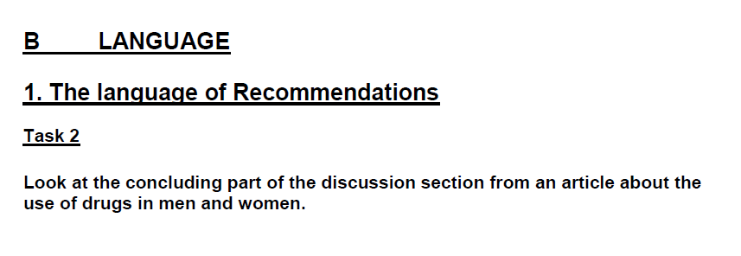
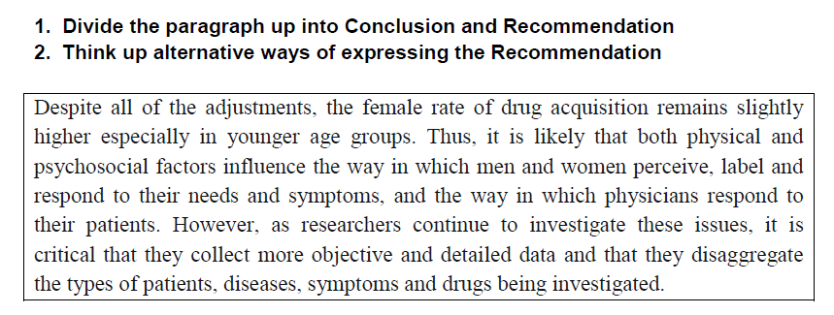
e.g. change sentence word order/use passive

Slide 12
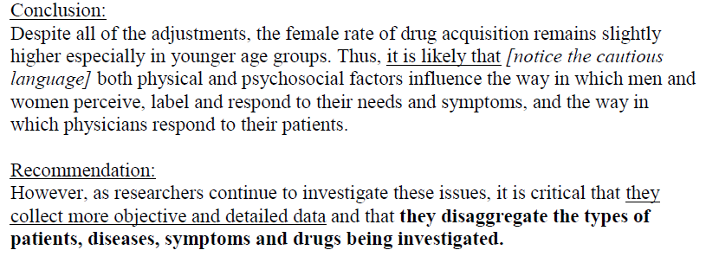
KEY
Why this should be done – How will this help move research forward?
What should be done

Slide 13
Suggestions
a) In future studies more objective and detailed data should be collected and the types of patients, diseases, symptoms and drugs being investigated should be disaggregated.
b) More work needs to be done in this area; data should be collected more objectively, and the types of patients, diseases, symptoms and drugs being investigated need to be disaggregated.

Slide 14

Those annoying verbs again…

Slide 15
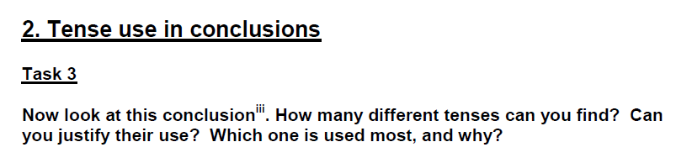
The dominant tense in the conclusion is mainly the simple present, as the writer presents the results as facts based on evidence and support within the thesis.

Slide 16
Two new analyses of steady-state operation of the Class E power amplifier have been presented [1. present perfect (passive), links past time (the writing) with the present (the presentation of the writing) in Chapter 3.
They use [2. simple present, fact about the analyses] different techniques and apply to different, but overlapping, domains characterised by circuit Q and normalised carrier frequency. Both analyses extend [2] existing theoretical knowledge of the circuit and provide [2] useful information for practising electronic engineers who wish to design a Class E amplifier.
The key findings from the first (power series) analysis are [2] expressions for component values for finite Q circuits, and an estimate of the unwanted harmonic output.
These were previously only known [3. simple past (passive), at a time before this study] from numerical solutions at spot values of Q and frequency.

Slide 17
The existence of the power series solution confirms [2] that exact Class E conditions are [2] possible for finite Q, but no longer coincide [2] with peak efficiency. This analysis also gives [2] expressions for the carrier frequency response, but for most purposes these are [2] superseded by those obtained by considering energy conservation. Finally, the power series analysis gave rise to [4. simple past, describing the procedure, what the researcher did] the insight that the role of the drain feed choke is [2] simply to feed a current into the rest of the circuit; this then led [4] to the amplitude modulation theory given in Chapter 4. [= that was given/that has been given]

Slide 18
The significant results from the second (energy conservation) analysis are [2] simple rational functions giving the frequency response of the Class E PA over the entire central region. This fills [2] a long-standing knowledge gap, which may [hedging] have seriously limited [1. past modal form, describing the result of something that happened in the past] the practical usefulness of this circuit.
...The expressions from the first analysis provide [2] results which agree with published numerical solutions. The findings of the second analysis agree [2] with published solutions and measured data.

Slide 19
A Typical Pattern
Present perfect (this thesis has discussed…)
[sometimes simple past: The previous chapters presented…]
Simple Present (the findings show…) with some hedging (this may be … )
[main claims]
Future (further investigations will need to be done)
[Sometimes present: More research is needed in order to…]

Slide 20

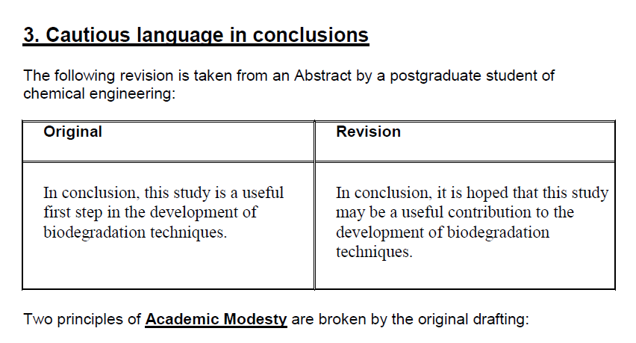
Your research is brilliant but…

Slide 21
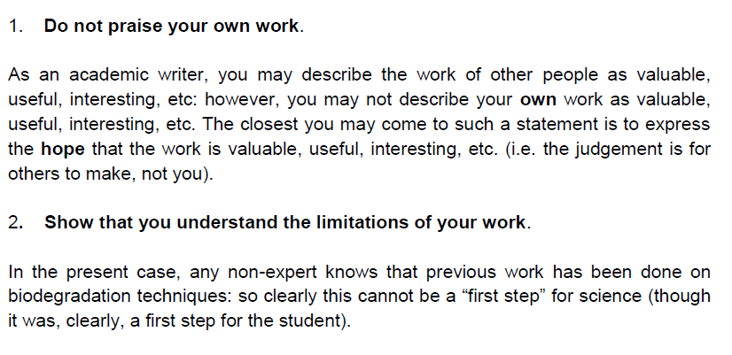

Slide 22
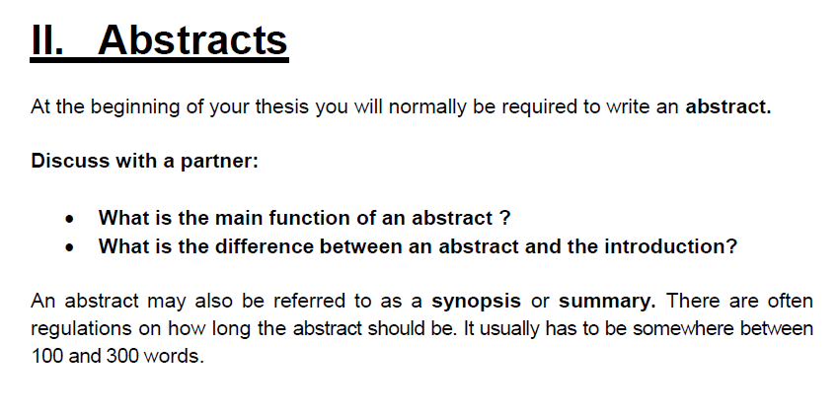


Slide 23
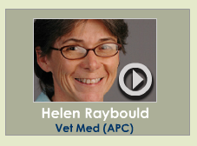

LISTEN AND COMPARE IDEAS
http://writing.ucdavis.edu/sciencewriters/uwp.html
“I should be able to give anybody the abstract and they should be able to understand it, even if they are not an expert in the field.”

Slide 24
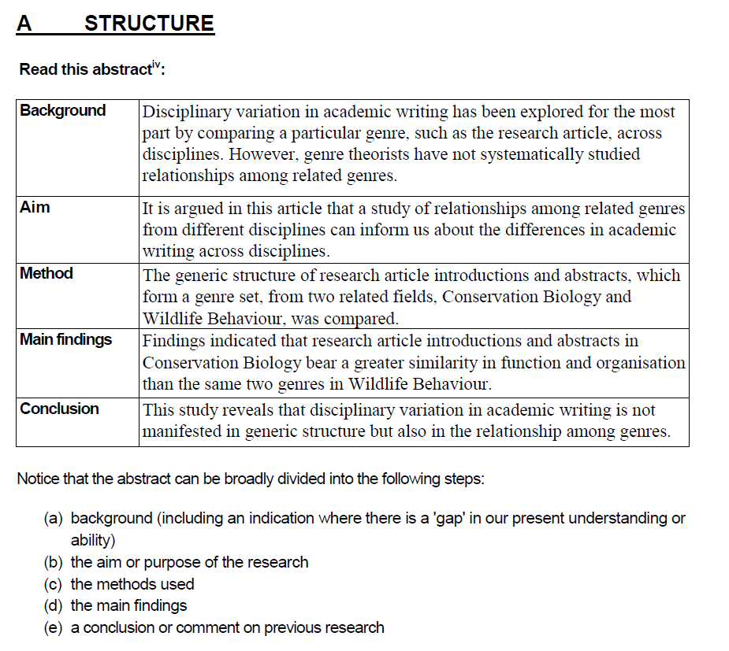

Slide 25
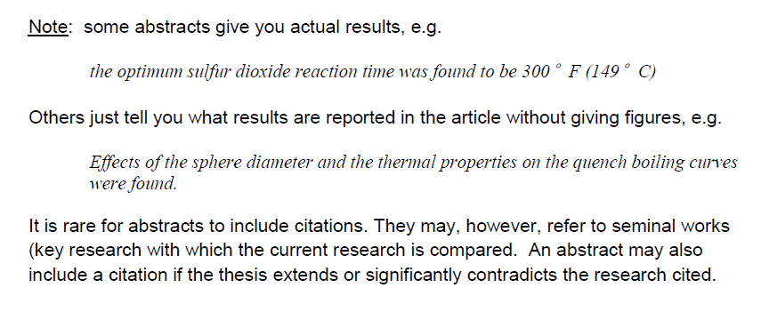
NOTES

Slide 26
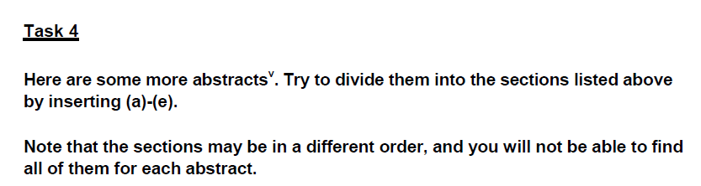
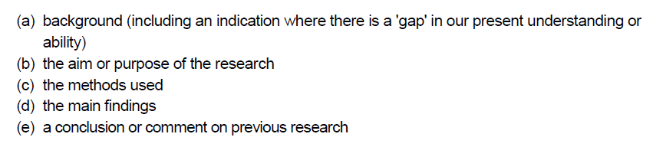

Slide 27
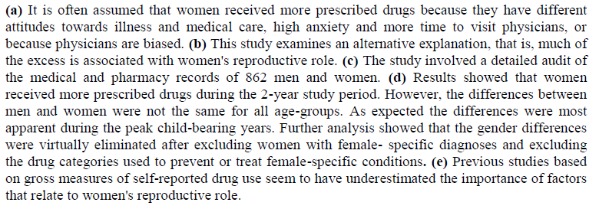
Abstract 1

Slide 28
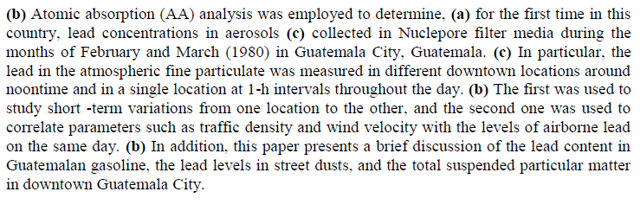
Abstract 2

Slide 29
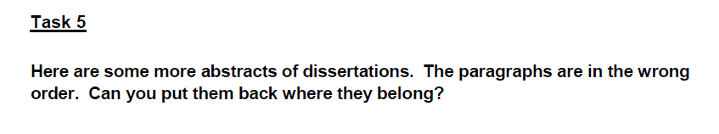

Slide 30
KEY
Correct order abstract 1:
2-4-3-1
Correct order abstract 2:
4-3-5-1-2

Slide 31
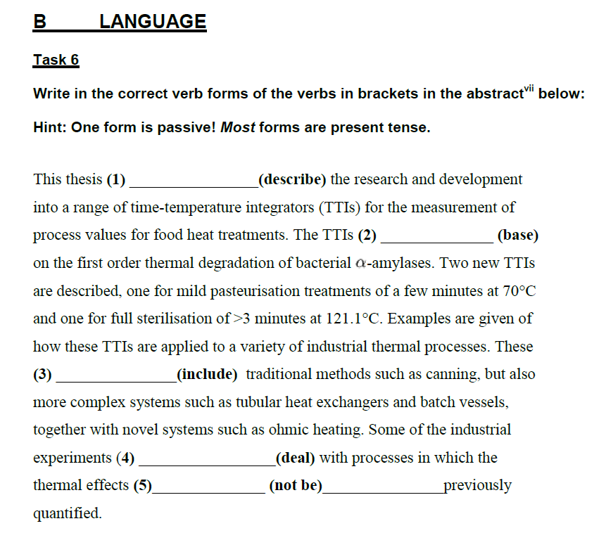

Slide 32
KEY
This thesis 1. describes the research and development into a range of time-temperature integrators (TTIs).
The TTIs 2. are based on the first order thermal degradation of bacterial -amylases.
These 3. include traditional methods such as canning, but also more complex systems such as tubular heat exchangers and batch vessels, together with novel systems such as ohmic heating.
Some of the industrial experiments 4. dealt with processes in which the thermal effects 5. had not been previously quantified.
This microorganism 6. exists in extreme conditions where it 7. metabolises in boiling volcanic pools; with elemental sulphur readily available, in water of high salinity, and in a reducing atmosphere.

Slide 33
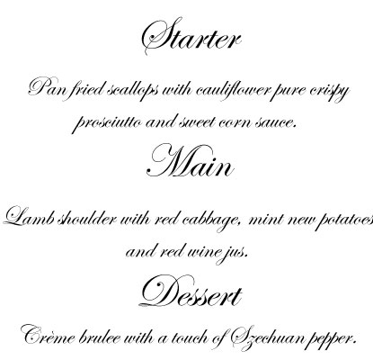
How is a thesis like a good meal at a restaurant?

Slide 34
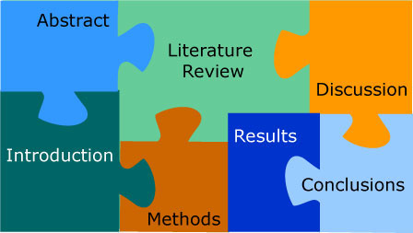
AN ABSTRACT SUMMARISES AND CONDENSES SO THAT A NON-EXPERT CAN UNDERSTAND WHAT YOU DID AND WHY

Slide 35
AN INTRODUCTION STARTS THE TEXT, CONTEXTUALISES & GUIDES THE READER TOWARDS THE REST OF YOUR RESEARCH

Slide 36
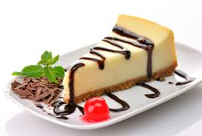
CONCLUSIONS END THE TEXT BUT CONNECT YOUR RESEARCH TO THE OUTSIDE WORLD

